Slide 1


MAVERICKS GEN AI DESIGNATHON
Agentic Creators

Slide 2


TEAM DETAILS
Team Name : Agentic Creators
Application Name : AI-powered Document Ingestion & Classification System
Team Member Details :
Teja – 2000123580
Prasanna – 2000123582
Sathwik – 2000123537
Jahnavi - 2000132260

Slide 3


Impact/Potential Value of the Application
The system will significantly reduce manual effort, cut errors, and provide full processing visibility for enterprises dealing with hundreds of thousands of unstructured documents daily (PDFs, Word files, scanned images, emails).
It addresses the problems of manual sorting being slow, costly, error-prone, and unscalable.

Slide 4

The Solution Proposed
Solution Highlights
Key Features / Approach
1) AI-powered Multi-Agent System (MAS)
2)Automated document ingestion, extraction, classification, and routing
3) Reduced manual work and errors
4) Full visibility on processing status
1) Decomposed Pipeline: Focuses on the Ingestor Agent as the primary functional component for Phase 1.
2) Agentic Framework: Uses an open-source agentic framework (e.g., LangChain or CrewAI) to structure the agents.
3) Central Message Bus: Implements a message bus (e.g., Kafka or a simpler equivalent for prototype) for communication between agents.
4) Web UI (Ingestion Panel): Provides a basic web interface for document upload (drag-and-drop or simple file selection).
5) Basic Metadata Capture: Captures fileName, fileSize, mimeType, source, priority, sender, folder.
6) doc.received Event: Generates a structured event payload for newly ingested documents.

Slide 5

Technologies Used
Programming Language: Python
Web Framework: Flask or FastAPI (for web_ui/app.py)
Message Bus: A simple in-memory queue (for prototype) or a lightweight message broker like Redis Pub/Sub, as a stand-in for Apache Kafka.
Agent Framework: Could be a basic custom implementation or a lightweight use of LangChain for agent structuring.
Frontend (for UI): Basic HTML/CSS/JavaScript, or a simple React component for drag-and-drop if following the template's suggestion.
State Management: For tracking document status, a simple in-memory dictionary or a basic Redis instance.

Slide 6
Gen AI Tool Utilization
LLM-Optional: Summarize Email Bodies: The Ingestor agent may include a placeholder for this capability, demonstrating where LLMs would be integrated to extract subject/context from email bodies (though not fully implemented in Phase 1 prototype).
Implementation Note: For the prototype, you might just have a function that simulates calling an LLM and returns a hardcoded or simple summary.

Slide 7
System Architecture, Functionalities and Design Diagram
Flow of Data and Processing Steps (Phase 1):
Document Upload/Event: A user uploads a file via the Web UI (e.g., a PDF, Word document, or image). This simulates File-share events, email hooks, or upload API calls.
Ingestor Agent Activation: The Ingestor agent receives the raw document payload and associated metadata.
Priority Decision (Simulated): The Ingestor applies a simulated priority decision based on sender, file size, or folder (e.g., if filename contains "URGENT," assign high priority).
doc.received Event Emission: The Ingestor agent creates and emits a doc.received event to the Message Bus. This event includes the document data (e.g., Base64 encoded binary) and extracted metadata.
Status Update: The Web UI updates the status of the document to "Ingested".Components Involved and Their Interactions (Phase 1)

Slide 8
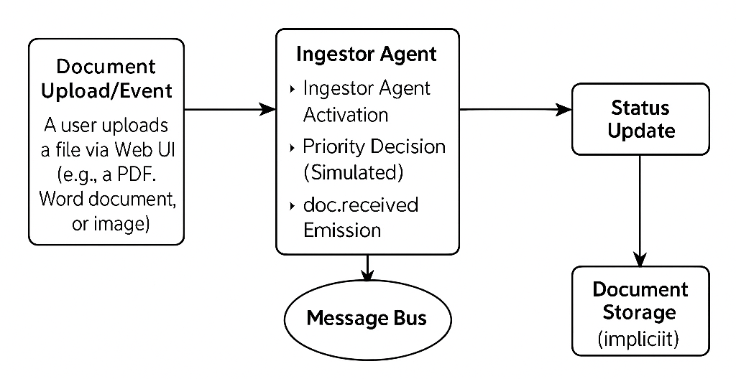
System Architecture, Functionalities and Design Diagram

Slide 9
System Architecture, Functionalities and Design Diagram
Components Involved and Their Interactions (Phase 1)
Web UI: Provides the "Upload/Ingestion Panel" for user interaction with the system.
It sends the document to the ingestor's upload endpoint.
Ingestor Agent: The core component of Phase 1. It receives documents, extracts initial metadata,
applies priority, and publishes the doc.received event to Message Bus.
Message Bus: The central communication hub. It receives the doc.received event from the
ingestor agent and makes it available for other (future) agents to consume.
For Phase 1, it primarily shows the ingestor output.

Slide 10
Solution Alignment with Hexaware’s Objective
The proposed solution closely aligns with Hexaware’s core objectives of automation-first transformation, AI-driven innovation, and cloud-native agility:
Automation-First Strategy
By automating document ingestion, metadata extraction, and event generation, the solution minimizes manual intervention and enables faster processing. This directly supports Hexaware’s goal of driving efficiency through hyperautomation.
Data-Driven Enablement
Capturing and structuring metadata enables advanced analytics and decision-making, reinforcing Hexaware’s focus on data-led transformation and insight generation.
Enhanced User Experience The intuitive and responsive Web UI offers a seamless interface for users to upload and track documents—demonstrating Hexaware’s commitment to user-centric digital experiences.

Slide 11


How it works
Functional Architecture
A user interacts with the Upload/Ingestion Panel in the Web UI to submit a document. This document is received by the Ingestor Agent. The Ingestor agent performs initial processing, like determining priority based on simple rules, and then creates a structured doc.received event. This event, containing the raw document and its metadata, is published to the Message Bus. The Web UI updates to show the document's status as "Ingested".

Slide 12
How it works
Technical Architecture
The web_ui/app.py runs a basic web server (e.g., using Flask) that exposes an upload endpoint. When a file is uploaded, the ingestor.py script is triggered (or integrated directly into the app.py for simplicity in prototype). The Ingestor then pushes the document and its metadata into a simple in-memory queue or Redis (acting as the Message Bus). The main.py orchestrates the startup of both the web UI and the Ingestor.

Slide 13
Innovation and Creativity
Agentic Approach: Even in Phase 1, demonstrating the foundational setup for a modular, agent-based system sets it apart from monolithic applications.
Visibility: The commitment to real-time status updates in the UI from the very first phase (showing "Ingested" status) is a key innovation.
LLM-Readiness: Highlighting the planned integration points for Generative AI (like email summarization) even if it's a placeholder, shows foresight.

Slide 14
Scalability, Performance and Security
Scalability: The modular agent architecture and use of a message bus (even simulated) lays the groundwork for horizontal scaling in future phases.
Performance: For Phase 1, focus on ensuring the upload and initial ingestion steps are responsive.
Security: Acknowledge the importance of future security measures like virus scanning for attachments and secure API endpoints.

Slide 15
Best practices and industry standards followed
Modular Design: Separating concerns into distinct agents and shared services.
Event-Driven Architecture: Using a message bus for inter-agent communication
Clear Project Structure: Following the recommended Python project layout.
Version Control: Using Git for code management.

Slide 16
User Experience
Simple Upload: An intuitive drag-and-drop or file selection area.
Immediate Feedback: Documents appear in a list, and their status updates to "Ingested" in near real-time.

Slide 17
Console Output Details
https://github.com/prasanna756/Agentic-Creators

Slide 18

THANK YOU

